Slide 1

Interpreting Ecological Niche Modeling

Slide 2
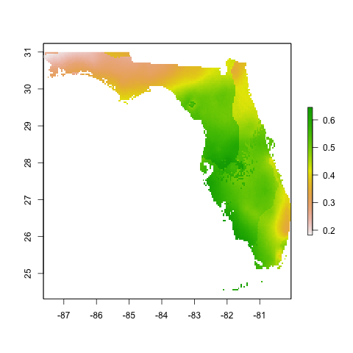
Interpreting ENMs
Step 1: Look at the output

Slide 3
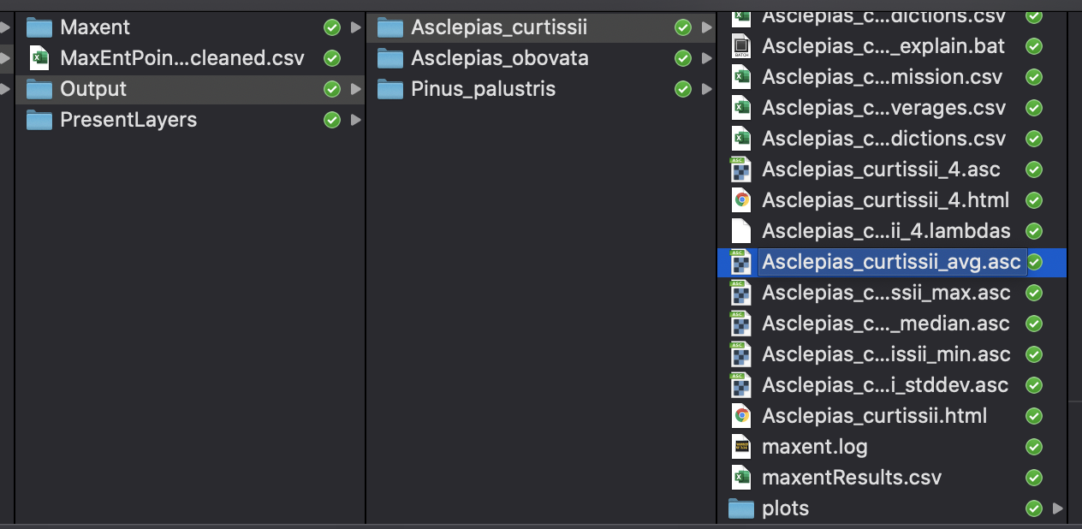
Interpreting ENMs
Step 1: Look at the output
We will use this average file for all other analysis

Slide 4
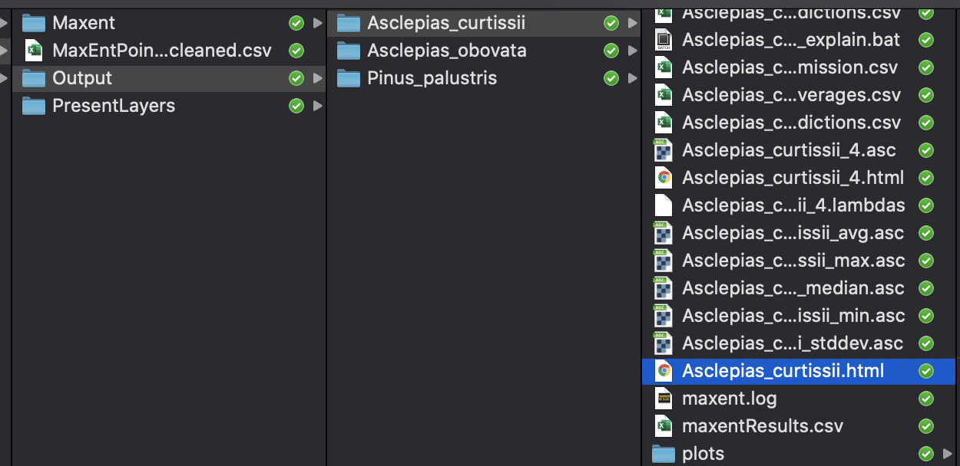
Interpreting ENMs
Step 1: Look at the output
But first, lets make sure the model is good!

Slide 5
Interpreting ENMs
Step 1: Look at the output
Step 2: Evaluate the models

Slide 6
Interpreting ENMs
Step 1: Look at the output
Step 2: Evaluate the models
How well can the model discriminate between occurrence points and background points? e.g., AUC

Slide 7
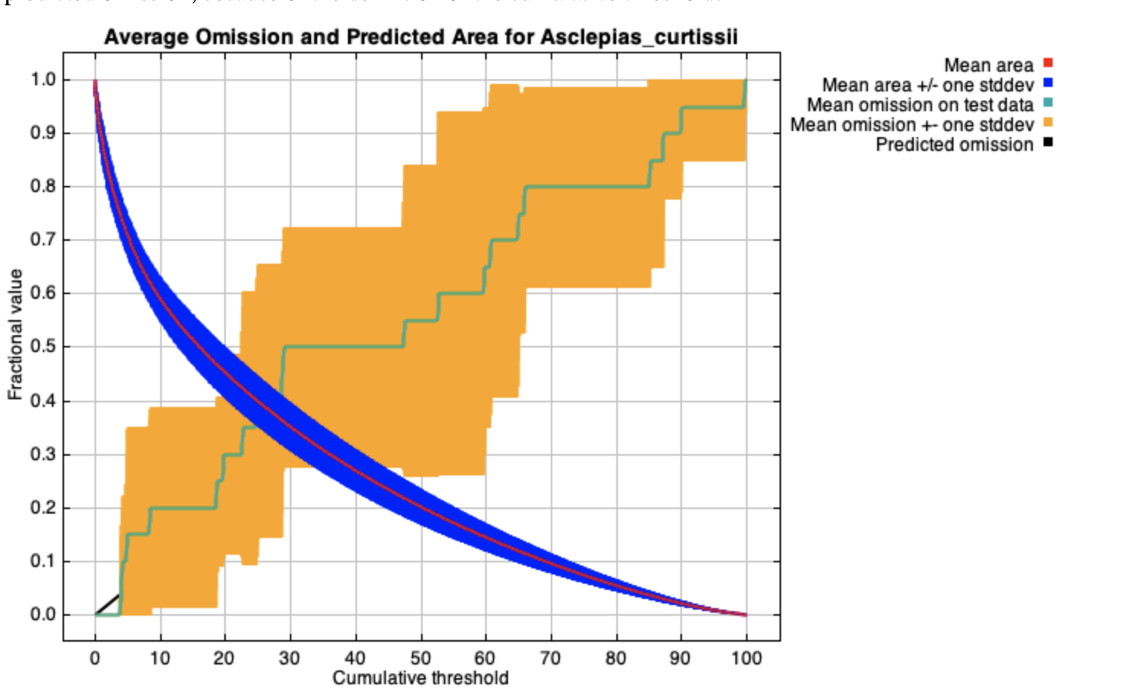
Model Statistics
The test omission rate and predicted area as a function of the cumulative threshold
Omission:
the proportion of a given sample of actual presences that have probabilities of occurrence (or habitat suitability values) below a binarization threshold.
Omission rate should be close to the predicted omission

Slide 8
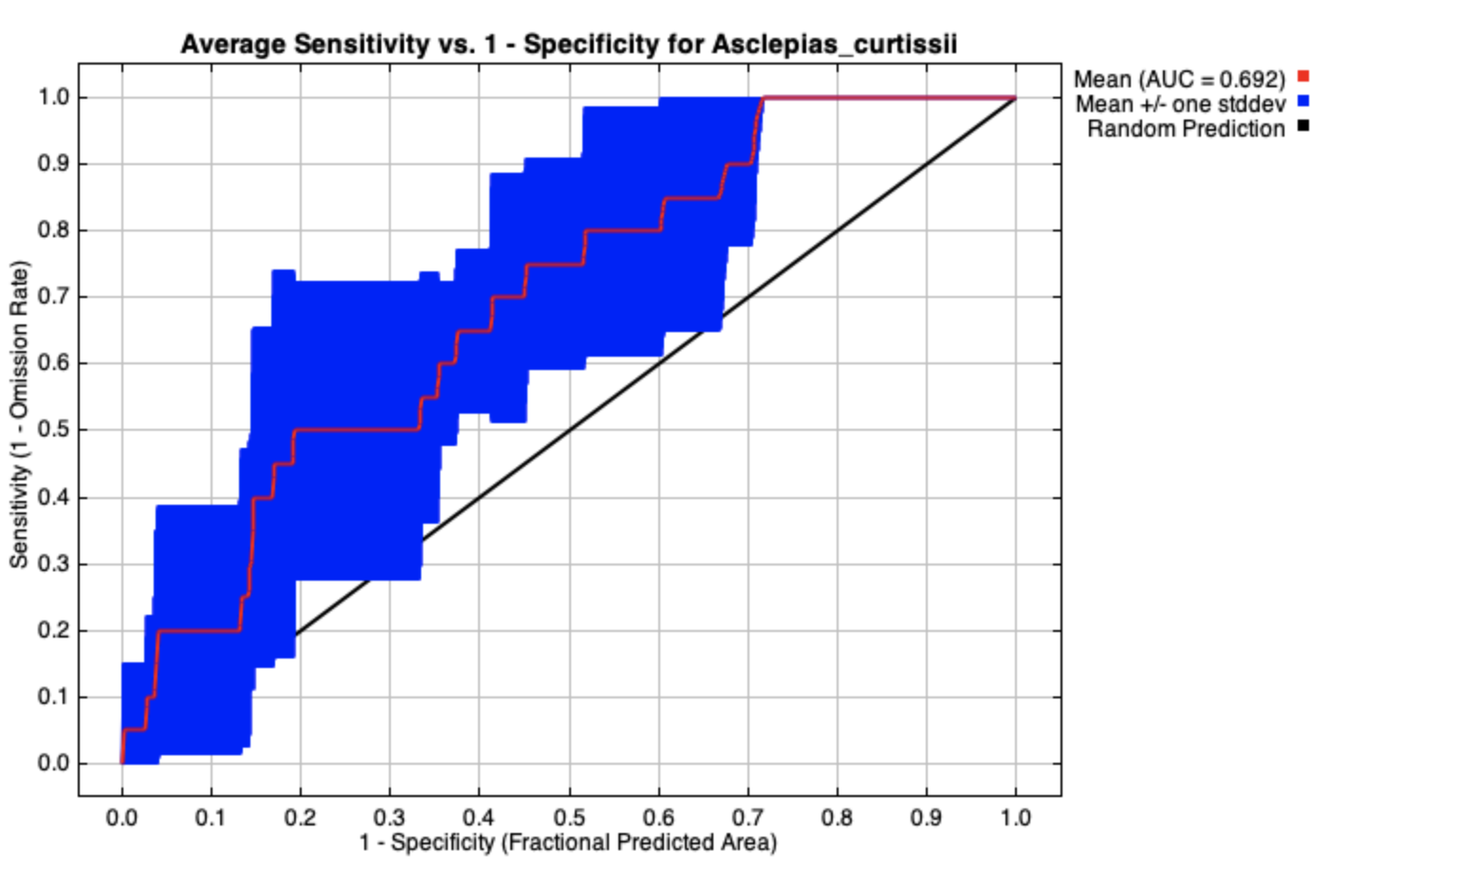
Model Statistics
Area under the curve (AUC) of the Receiver Operating Characteristic (ROC) curve
AUC should be over 0.8

Slide 9
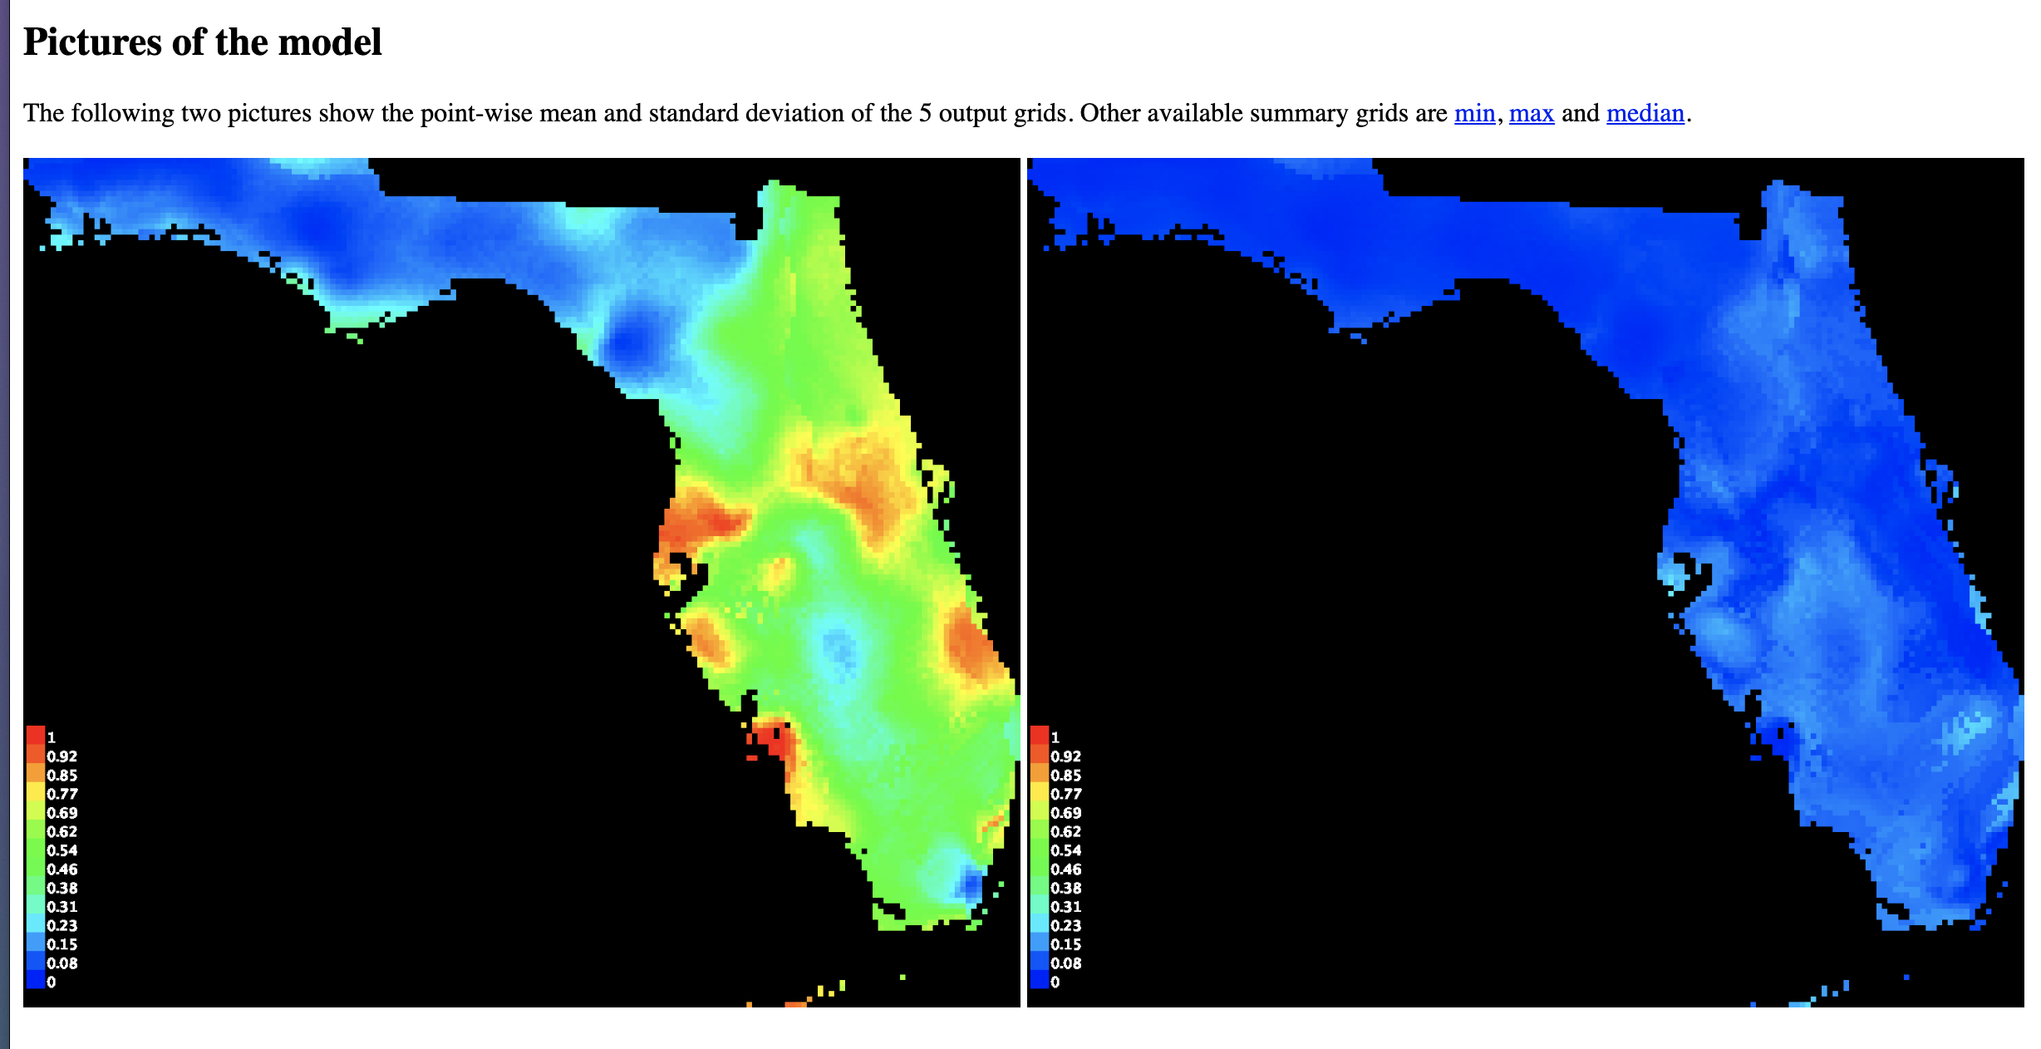
Pictures of the Model

Slide 10
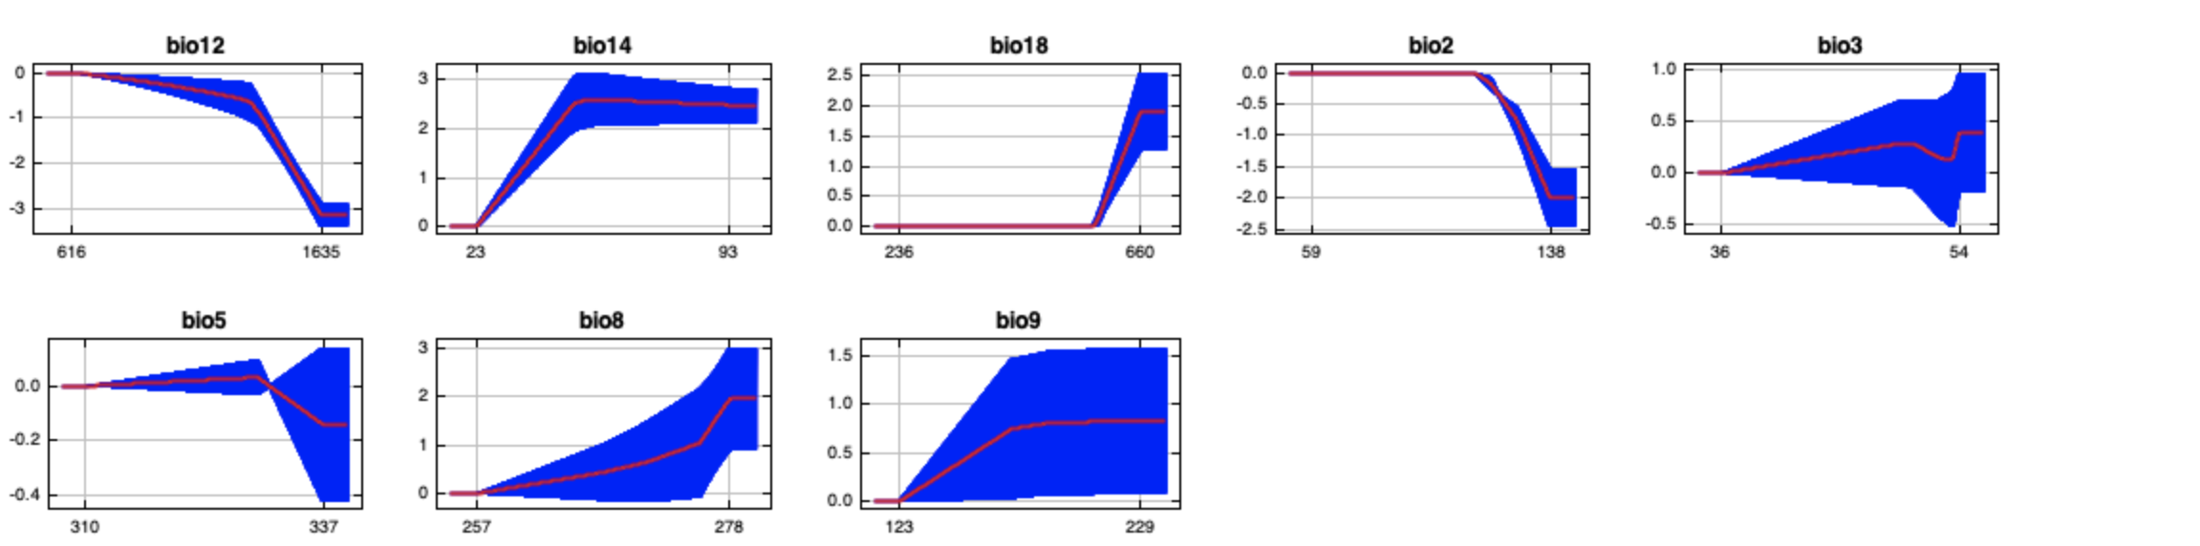
Response curves
Response curves show how each environmental variable affects the Maxent prediction

Slide 11
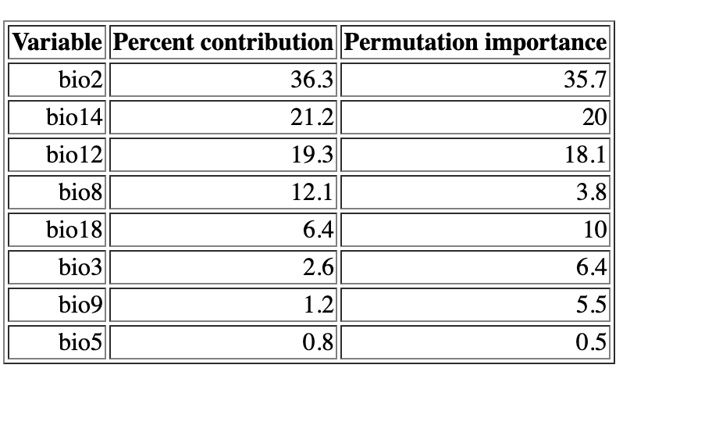
Variable contribution
For this model, we found the largest percent contribution with mean diurnal range (36.3%), followed by precipitation of driest month (21.2%) and annual precipitation (19.3%).

Slide 12
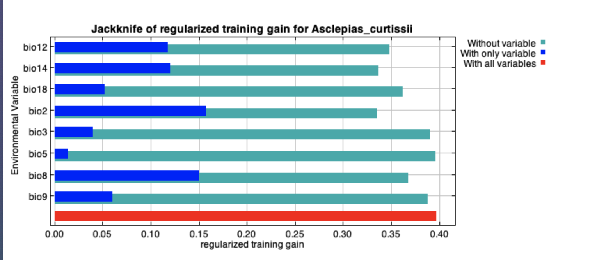
Variable performance
Shows the importance of variables

Slide 13
Interpreting ENMs
Step 1: Look at the output
Step 2: Evaluate the models
Step 3: Additional analysis

